Slide 1
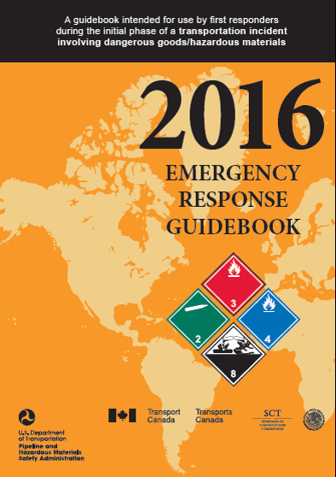
ERG2016 Training Presentation
How to use the DOT ERG 2016

Slide 2
ERG2016
The Emergency Response Guidebook 2016 (ERG2016) is a guide to aid first responders during an incident involving dangerous goods in transport:
By quickly identifying the specific or generic hazards of the material(s) involved; and
Protecting themselves and the general public during the initial response phase of the incident.
Before an emergency – become familiar with this guidebook! Without the proper training/equipment, do not assume offensive roles during an incident.

Slide 3
Outline
Overview of the ERG2016
How to use the ERG2016
Other information in the guide
BLEVE (Boiling Liquid Expanding Vapor Explosion)
Indicators of CBRN (Chemical, Biological, Radiological, Nuclear)
IED (Improvised Explosive Device)
Emergency Contact
Overview
Usage
Other info

Slide 4
ERG2016 - Overview
Overview
Usage
Other info
CANUTEC

Slide 5
Overview of the ERG2016
The main sections are:
ERG2016 Usage Flowchart (page 1)
Table of Markings, Labels and Placards and Initial Response Guide to use on-scene (pages 8-9)
Rail car Identification Chart (pages 10-11)
Road trailer Identification Chart (pages 12-13)
YELLOW Section (list of materials by ID (UN) number)
BLUE Section (list of materials by name)
ORANGE Section (appropriate emergency measures guides)
GREEN Section (initial isolation and protective action distances for highlighted substances)
Overview
Usage
Other info
CANUTEC

Slide 6
Additional Sections
Other ERG2016 Sections and Pages:
Shipping Documents (inside front page cover)
Local Emergency Telephone Numbers (populated by user) (page 2)
Table of Contents (page 3)
Safety Precautions (page 4)
Hazard Classification System (page 6)
Globally Harmonized System of Classification and Labeling of Chemicals (GHS) (pages 14-15)
Hazard Identification Numbers displayed on some Intermodal Containers (pages 16-19)
Pipeline Transportation (pages 20-25)
Overview
Usage
Other info
CANUTEC

Slide 7
Additional Sections (continued)
Other ERG2016 Sections and Pages:
Protective Actions (pages 291-292)
Protective Clothing (pages 363-364)
Fire and Spill Control (pages 365-367)
BLEVE – Safety Precautions (page 368-369)
Criminal / Terrorist use of chemical / Biological / Radiological agents (pages 370-373)
Improvised Explosive Device (IED) (pages 374-375)
Glossary (pages 376-386)
Emergency Response Assistance Plans (ERAP) (page 391)
Overview
Usage
Other info
CANUTEC

Slide 8
YELLOW Section
In this section, the substances are listed in numerical order of their 4-digit ID (UN) numbers.
The ID (UN) number is followed by the 3-digit guide number (ORANGE Section) to refer to, as well as the name of material.
Please note that some substances are highlighted in GREEN and should be treated specifically by referring to the GREEN Section for initial isolation and protective action distances. The ORANGE Section may be consulted for other safety measures.
Overview
Usage
Other info
CANUTEC

Slide 9
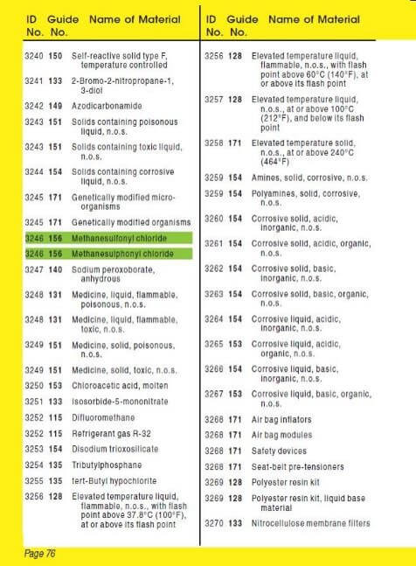
Refer to the
GREEN Section

Slide 10
BLUE Section
In this section, the substances are listed in alphabetical order of the material’s name.
The name of the material is followed by the 3-digit guide number (ORANGE Section) to refer to, as well as the ID (UN) number.
Please note that some substances are highlighted in GREEN and thus, will have to be treated specifically by referring to the GREEN Section for initial isolation and protective action distances. The ORANGE Section may be consulted for other safety measures.
Overview
Usage
Other info
CANUTEC

Slide 11
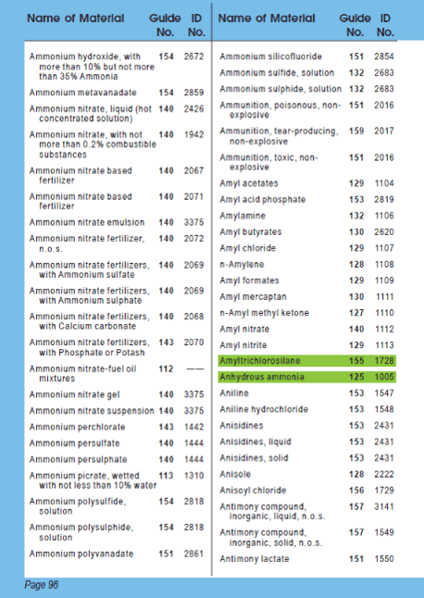
Refer to the GREEN Section

Slide 12
ORANGE Section
In this section, the substances are grouped into different categories. Each guide in the ORANGE Section represents a category with appropriate response measures.
There are three main parts in each guide:
Potential Hazards
Public Safety
Emergency Response
Overview
Usage
Other info
CANUTEC

Slide 13
ORANGE Section
Guide 112
Potential Hazards
Public
Safety
Emergency Response
Fire or
Explosion
Primary Information
Fire
Spill or
Leak
Health
Protective Clothing
First Aid
Evacuation
- Spill
- Fire
In Potential Hazards, the subsection Fire or Explosion or Health will appear first depending on the primary hazards of the type of substance.
Overview
Usage
Other info
CANUTEC

Slide 14
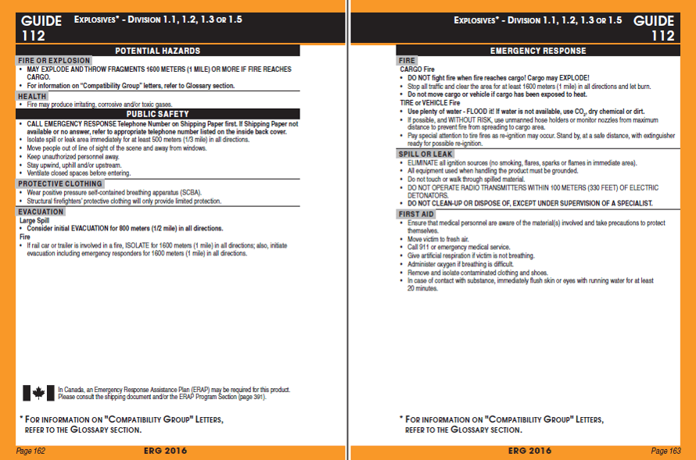
Primary Hazard (Fire or Explosion)
Secondary Hazard (Health)

Slide 15
ORANGE Section
The Potential Hazard Section provides:
Information on health and fire / explosion
The Public Safety Section provides:
Immediate isolation distance, regardless of the quantity involved;
Type of protective clothing and respiratory protection;
The Evacuation Subsection provides :
A suggested evacuation perimeter for large spill or fire situations AND/OR a reference to Table 1 - Initial Isolation and Protective Action Distances (GREEN Section).
These sections are always found on the left-hand page
Overview
Usage
Other info
CANUTEC

Slide 16
ORANGE Section
The Emergency Response Section provides:
Emergency measures in order to mitigate the incident;
Instructions to follow in case of a fire;
Actions to be taken in case of a spill/leak;
First aid measures.
This section is always found on the right-hand page
Overview
Usage
Other info
CANUTEC

Slide 17
ORANGE Section
In the YELLOW and BLUE Sections, if the substance is
not highlighted in GREEN:
Use the distances suggested in the ORANGE Section:
Isolate the area in all directions, as an immediate precautionary measure, to the minimum distance suggested under Public Safety, and increase the zone if needed;
Consider the evacuation distances suggested in the Subsection Evacuation – Spill / Fire.
Overview
Usage
Other info
CANUTEC

Slide 18
GREEN Section
If the material is highlighted in GREEN in the YELLOW and BLUE Sections, you may need to refer to the GREEN Section.
The GREEN Section of the ERG2016 consists of three parts :
TABLE 1 - Initial Isolation and Protective Action Distances;
TABLE 2 - Water-Reactive Materials which Produce Toxic Gases;
TABLE 3 - Initial Isolation and Protective Action Distances for Large Spills for Different Quantities of Six Common Toxic by Inhalation (TIH) Gases.
Overview
Usage
Other info
CANUTEC

Slide 19
GREEN Section - Table 1
TABLE 1 - Initial Isolation and Protective Action Distances suggests distances to protect people from vapours resulting from spills involving dangerous goods that are considered :
Toxic by inhalation (TIH);
Materials that produce toxic gases upon contact with water; or
Chemical warfare agents (when used as a weapon).
In this table, the substances are presented in numerical order of their ID (UN) numbers. Some materials indicate to consult Table 3 for more information.
Overview
Usage
Other info
CANUTEC

Slide 20
GREEN Section - Table 1 Cont’d
Table 1 provides, for small and large spills, the distances for:
The Initial Isolation Zone and,
The suggested Protective Action Zone, downwind, for day and night.
The distances show the areas likely to be affected during the first 30 minutes after the materials are spilled, and this distance could increase with time.
The responders must choose a protective action:
Evacuation;
Shelter in-place; or
A combination of both (see page 292 of the ERG2016).
Overview
Usage
Other info
CANUTEC

Slide 21
Table 1 - Small and large spills
The definitions are as follows:
Small spill: quantities equal or less than 208 litres (55 U.S. Gallons) for liquids and equal or less than 300 kilograms (660 pounds) for solids. Generally involves a single small package, a small cylinder, or a small leak from a large package.
Large spill: quantities greater than 208 litres (55 U.S. Gallons) for liquids and greater than 300 kilograms (660 pounds) for solids. Generally involves a spill from a large package, or multiple spills from many small packages.
Overview
Usage
Other info
CANUTEC

Slide 22
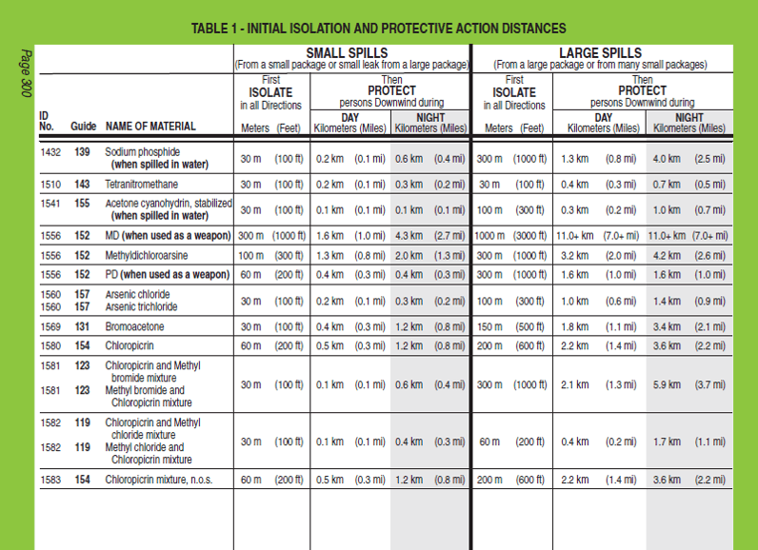

Slide 23
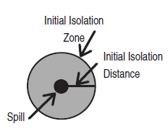
Table 1 - Initial Isolation Zone
Defines the radius of a zone (Initial Isolation Zone) surrounding the spill in ALL DIRECTIONS.
All public should be evacuated.
Protective clothing and respiratory protection is required.
Overview
Usage
Other info
CANUTEC

Slide 24
Table 1 - Protective Action Zone
Defines an area DOWNWIND from the incident in which people are at risk of harmful exposure. Protective action should be considered (evacuation, shelter-in-place or both).
For practical purposes, the Protective Action Zone is a square, whose length and width are the same as the downwind distance shown in Table 1 (see diagram in the following page).
Overview
Usage
Other info
CANUTEC

Slide 25
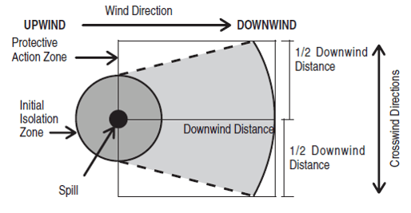
Table 1 - Protective Action Zone
The shape of the area in which protective actions should be taken (the Protective Action Zone) is shown in the figure below.
Overview
Usage
Other info
CANUTEC

Slide 26
Table 1 - Protective Action Zone
It is important to note that Protective Action Zones do not only depend on the mere presence of gases/vapours but mainly on its concentration in the air.
During the day
Increase of the atmospheric disturbances
Weaker toxic concentrations in the air
Smaller protective action zone
Greater dispersion of gases/vapours
During the night
Decrease of the atmospheric disturbances
Stronger toxic concentrations in the air
Greater protective action zone
Slow dissipation of gases/vapours
Overview
Usage
Other info
CANUTEC

Slide 27
GREEN Section - Table 2
TABLE 2 – Water-Reactive Materials which Produce Toxic Gases contains:
A list of materials which produce large amount of Toxic Inhalation Hazard (TIH) gases when spilled in water and identifies the TIH gases produced.
The substances are presented in numerical order of their ID (UN) numbers.
These Water-Reactive materials are easily identified in Table 1 as their name is immediately followed by (when spilled in water).
Overview
Usage
Other info
CANUTEC

Slide 28
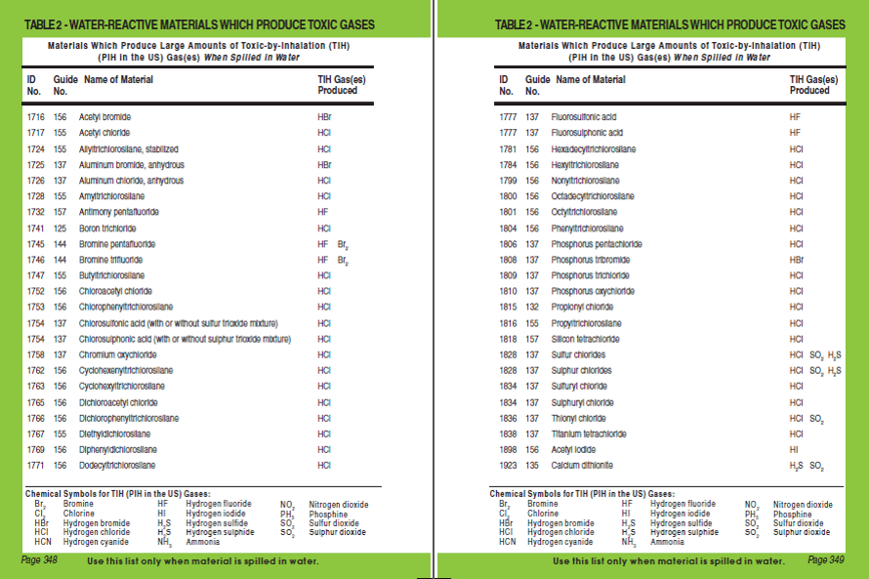

Slide 29
GREEN Section - Table 2
Important:
Some Water Reactive materials are also TIH materials themselves (e.g., Bromine trifluoride, UN1746). In these instances, two entries are provided in Table 1:
One for when spilled on land;
The other for when spilled in water.
If the Water Reactive material only has one entry in Table 1 (when spilled in water) and the product is NOT spilled in water, Table 1 and Table 2 do not apply and safety distances will be found within the appropriate ORANGE guide (e.g., Antimony pentafluoride, UN1732).
Overview
Usage
Other info
CANUTEC

Slide 30
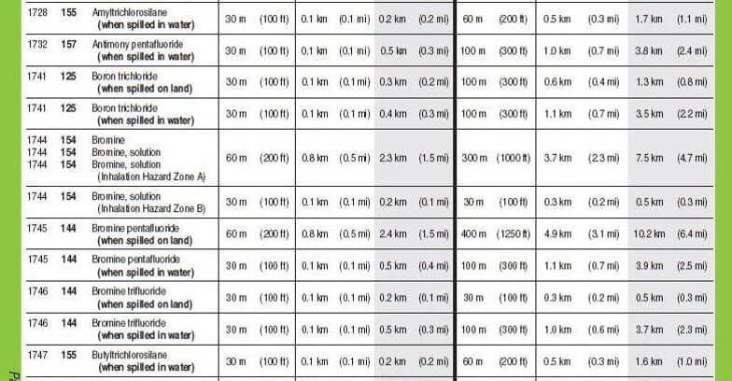
Not a TIH, only Water Reactive material
TIH and Water Reactive material

Slide 31
GREEN Section - Table 3
TABLE 3 – Initial Isolation and Protective Action Distances for Large Spills for Different Quantities of Six Common TIH Gases contains:
A list of Toxic Inhalation Hazard materials that may be more commonly encountered.
The materials are:
Ammonia, anhydrous (UN1005);
Chlorine (UN1017);
Ethylene oxide (UN1040);
Hydrogen chloride, anhydrous (UN1050) and Hydrogen chloride, refrigerated liquid (UN2186);
Hydrogen fluoride, anhydrous (UN1052);
Sulfur dioxide / Sulphur dioxide (UN1079).
Overview
Usage
Other info
CANUTEC

Slide 32
GREEN Section - Table 3
Important:
The materials are presented in alphabetical order and provide initial isolation and protective action distances for LARGE SPILLS (more than 208 litres or 55 US gallons) involving different container types (therefore, different volume capacities) for day time and night time situations and different wind speeds.
They will be identified in Table 1 with the mention: Refer to Table 3.
Overview
Usage
Other info
CANUTEC

Slide 33
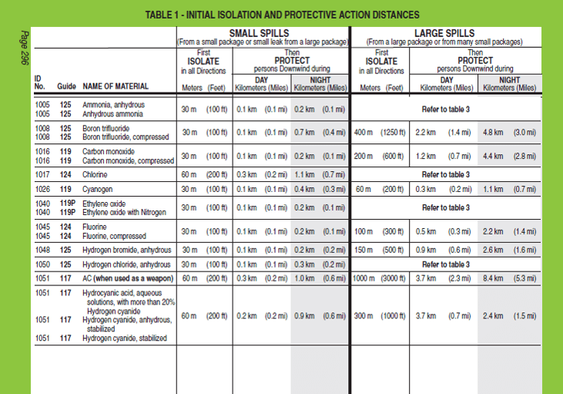

Slide 34
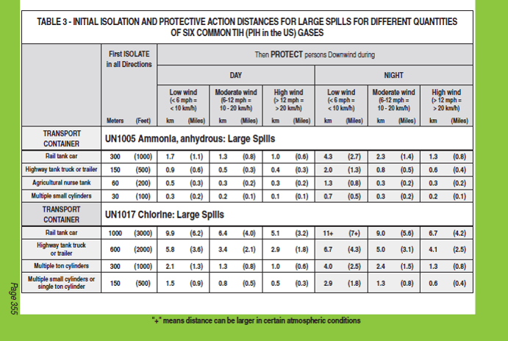

Slide 35
Overview – Question 1
You are facing a chlorine spill, in which section would you start looking for the information?
Yellow
Blue
Orange
Green
Overview
Usage
Other info
CANUTEC

Slide 36
Overview – Question 1 (Answer)
You are facing a chlorine spill, in which section would you start looking for the information?
Yellow
Blue
Orange
Green
Overview
Usage
Other info
CANUTEC

Slide 37
Overview – Question 2
You are facing a chlorine spill, what is the Guide Number and what is the ID (UN) number for chlorine?
124 , 1749
173 , 3520
124 , 1017
143 , 9191
Overview
Usage
Other info
CANUTEC

Slide 38
Overview – Question 2 (Answer)
You are facing a chlorine spill, what is the Guide Number and what is the ID (UN) number for chlorine?
124 , 1749
173 , 3520
124 , 1017
143 , 9191
Reference: ERG2016 Page 105
Overview
Usage
Other info
CANUTEC

Slide 39
Overview – Question 3
Under Potential Hazards in the ORANGE Section, in what order are the hazards?
They are in alphabetical order
They are in numerical order
The greatest hazard is listed first
There is no particular order
Overview
Usage
Other info
CANUTEC

Slide 40
Overview – Question 3 (Answer)
Under Potential Hazards in the ORANGE Section, in what order are the hazards?
They are in alphabetical order
They are in numerical order
The greatest hazard is listed first
There is no particular order
Overview
Usage
Other info
CANUTEC

Slide 41
Overview – Question 4
You are facing a chlorine multiple ton cylinders leak, what is the distance for First Isolate in all directions?
1000 m
600 m
300 m
150 m
Overview
Usage
Other info
CANUTEC

Slide 42
Overview – Question 4 (Answer)
You are facing a chlorine multiple ton cylinders leak, what is the distance for First Isolate in all directions?
1000 m
600 m
300 m
150 m
Reference: ERG2016 Page 355 – Multiple Ton Cylinders
Overview
Usage
Other info
CANUTEC

Slide 43
Thinking Point
Why is there different distances provided for DAY-TIME and NIGHT-TIME spills?
For TIH gases, when the wind direction changes, would you modify the downwind isolation zone accordingly?
Overview
Usage
Other info
CANUTEC

Slide 44
ERG2016 - Usage
Overview
Usage
Other info
CANUTEC

Slide 45
ERG2016 - Usage
This chapter will demonstrate how to use the ERG2016 flowchart (Page 1 of the guidebook) for:
Explosives Placard;
Known Substance (ID (UN) number, Name);
Identifiable Placard Only (no ID (UN) number);
Identifiable Railcar or Road Trailer Only;
Little or no Information.
Overview
Usage
Other info
CANUTEC

Slide 46
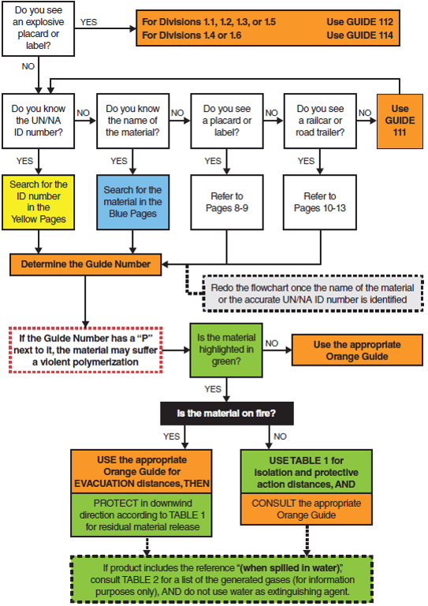
How to use the ERG2016
The flowchart is found on Page 1 of the ERG2016.
This flowchart will help you choose the correct guide page for your incident – given the information that is available.
Start the flowchart at the top, left hand corner, and follow until your situation applies.

Slide 47
How to use the ERG2016
Explosives Placard
Overview
Usage
Other info
CANUTEC

Slide 48
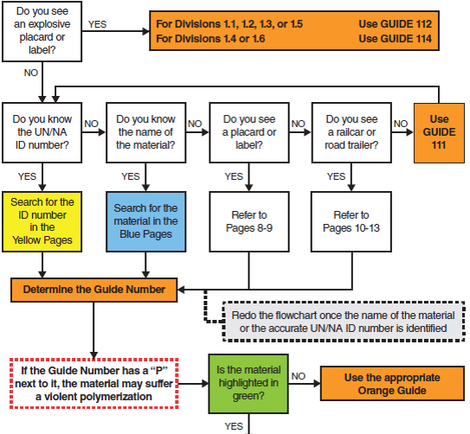
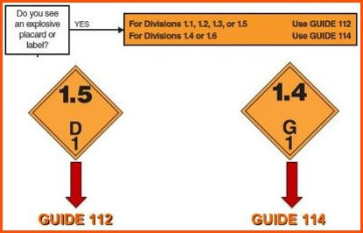
Explosives Placard - YES
If you have answered YES to the question “Do you see an explosive placard or label?”, refer to Guide 112 or 114 depending on the explosive’s division.

Slide 49
Explosives Example
Explosives are not listed in the ERG specifically by name or by ID (UN) number.
The Emergency Response Actions should be based only on the division of the explosive, not the individual explosive.
Overview
Usage
Other info
CANUTEC

Slide 51
How to use the ERG2016
Known Substance
(ID (UN) number, Name)
Overview
Usage
Other info
CANUTEC

Slide 52
ID Number and/or Name- YES
If you have answered NO to the previous question on Explosives, you continue to the next questions: Do you know the ID number (UN/NA) or the Name of the Material?
Overview
Usage
Other info
CANUTEC

Slide 53
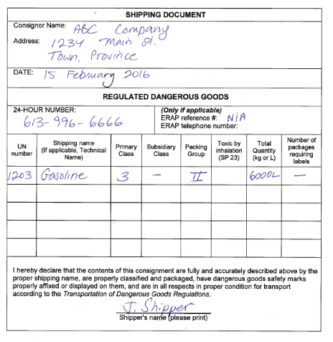
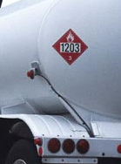
ID Number or Shipping Name
If the 4-digit ID number (UN or NA) is known (from a placard or shipping document), go to the YELLOW Section (list of products by ID number) and look up the appropriate Guide Number.

Slide 54
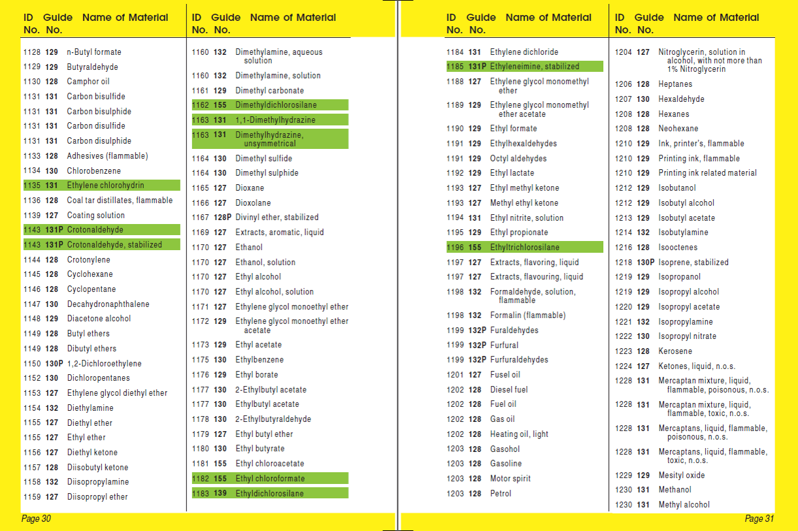
Orange Guide number

Slide 55
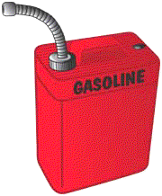
ID Number or Shipping Name
If the shipping name is known (from a shipping document or package), go to the BLUE Section (list of products in alphabetical order) and look up the appropriate Guide Number.

Slide 56
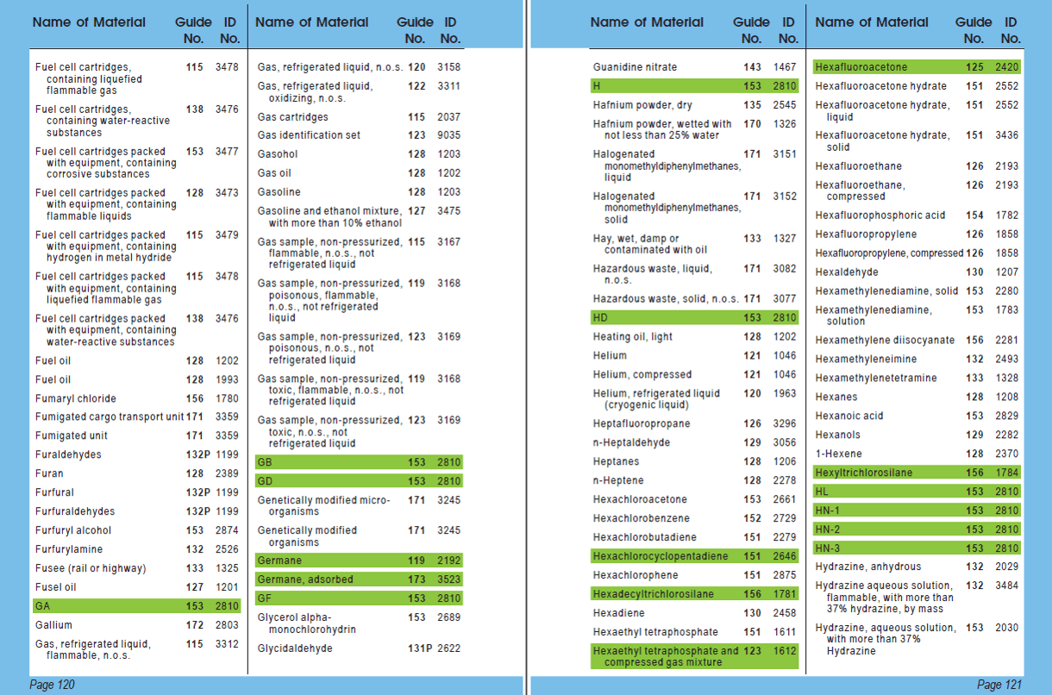
Orange Guide Number

Slide 57
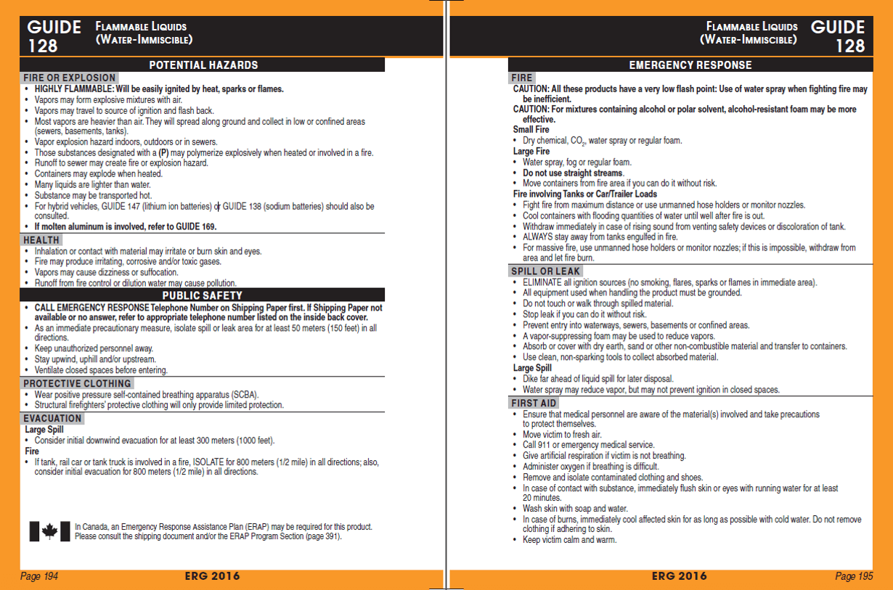

Slide 58
How to use the ERG2016
Identifiable Placard only
(no ID (UN) number)
Overview
Usage
Other info
CANUTEC

Slide 59
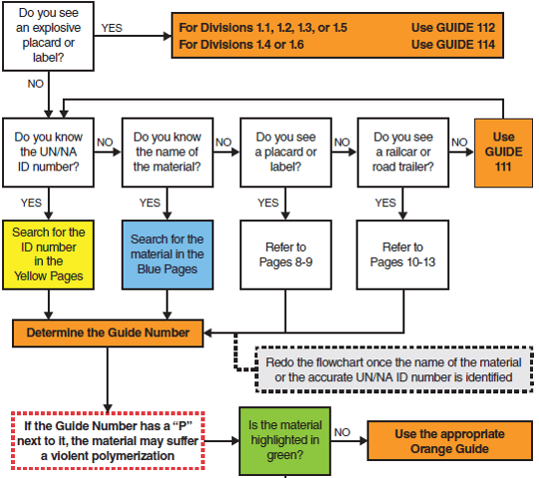
Placard or Label (no ID Number/Name)
If the substance cannot be identified by its ID (UN) number or by its name, but a placard or label is visible, refer to pages 8-9 of the ERG2016.
Class 3 placard is used as an example.

Slide 60
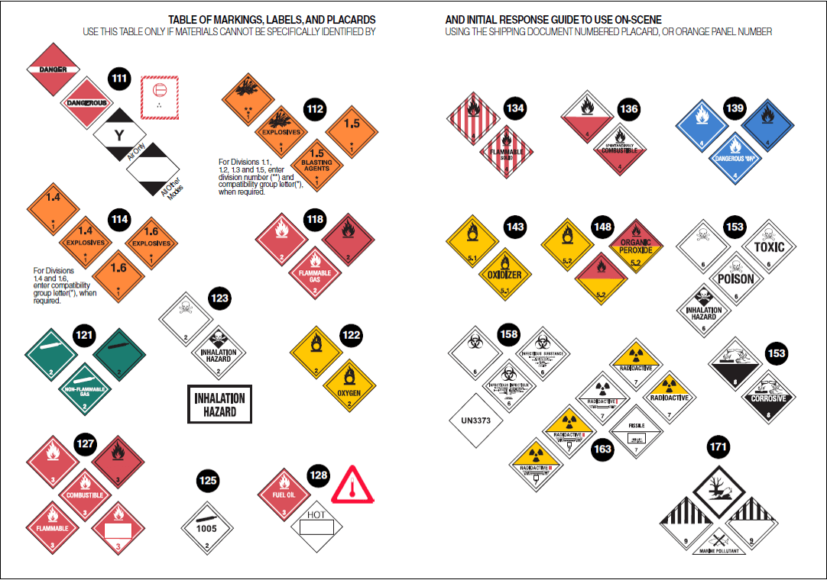
Guide Number
Class 3 Placard

Slide 61
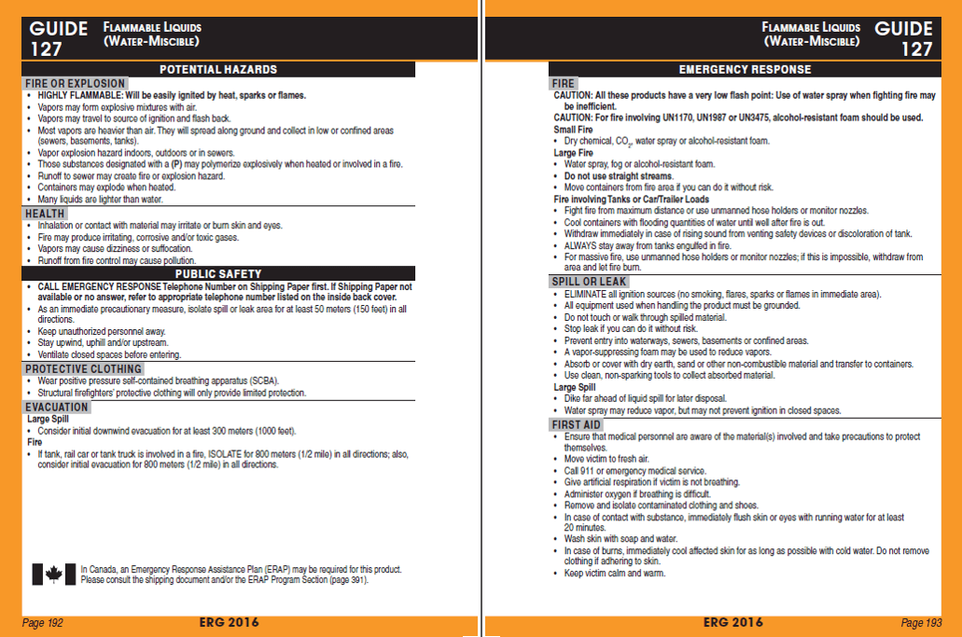

Slide 62
How to use the ERG2016
Identifiable Railcar
or
Road Trailer Only
Overview
Usage
Other info
CANUTEC

Slide 63
Railcar or Road Trailer (no ID Number/Name/Placard)
In some situations, it may be difficult to identify the substance.
However, the means of transport (railcar or road trailer) could reveal the potential danger.
Refer to pages 10-13 of the ERG2016.

Slide 64
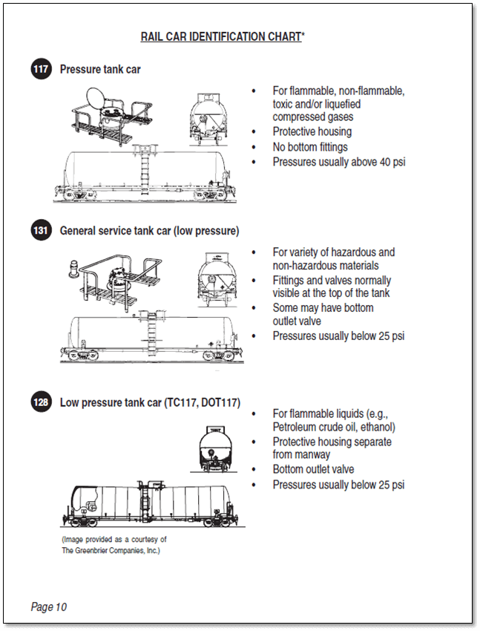
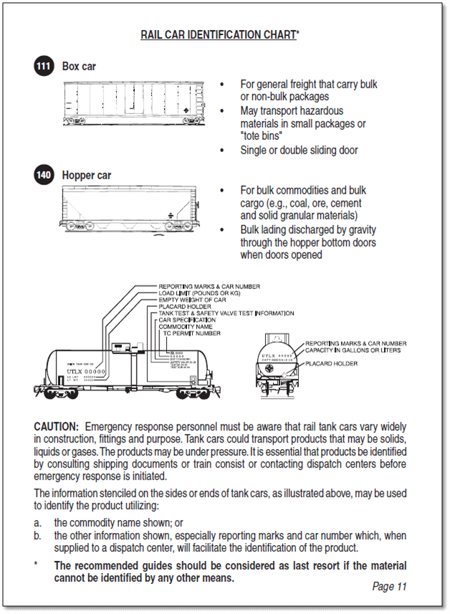

Slide 65
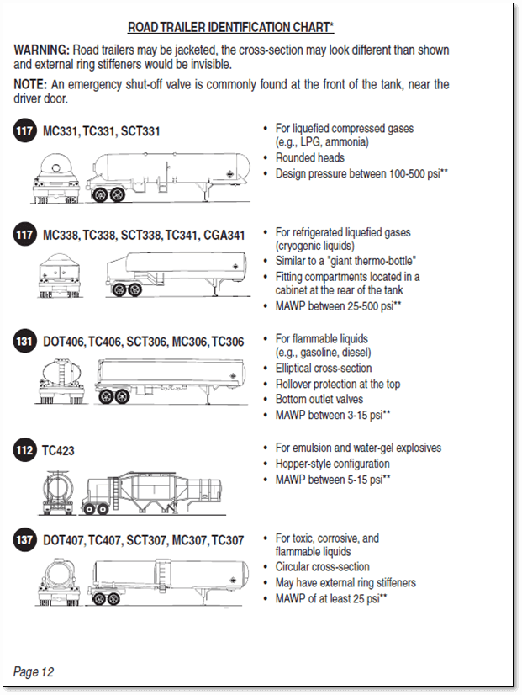
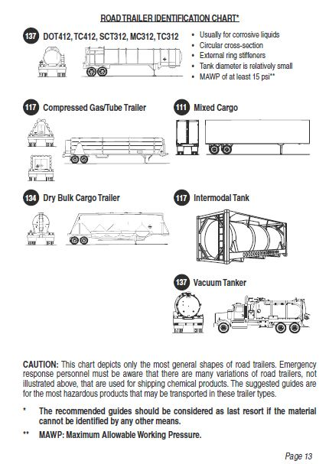

Slide 66
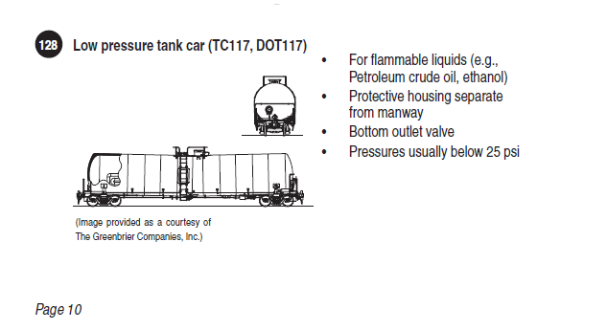
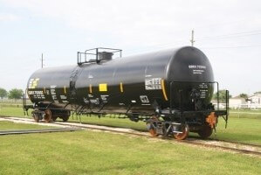
Railcar or Road Trailer
In the ERG2016, for each silhouette of railcar or road trailer, there are written visual clues to identify the means of transport. Once you have identified the means of transport, refer to the appropriate Guide Number.
Guide No.

Slide 67
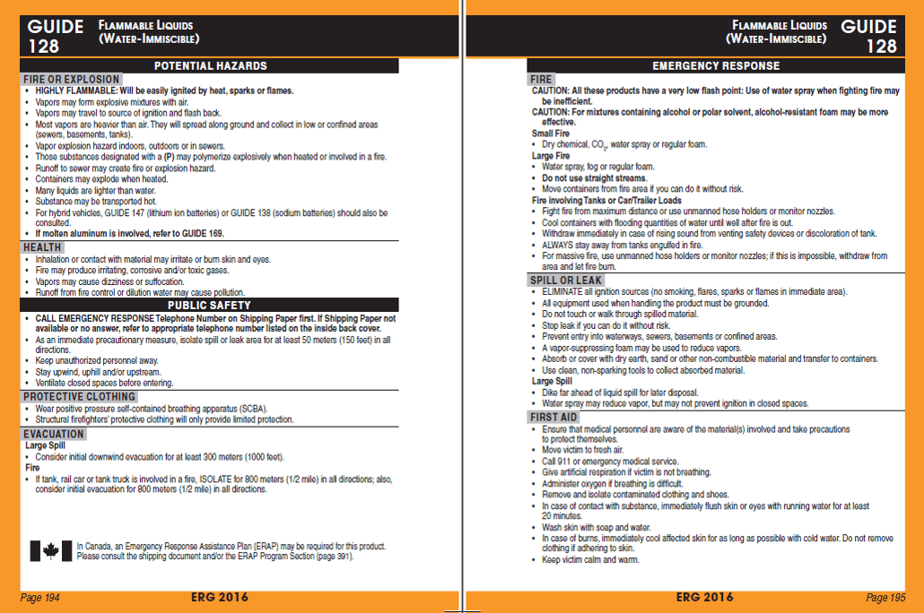

Slide 68
How to use the ERG2016
Little or No Information, or Danger Placard
Overview
Usage
Other info
CANUTEC

Slide 69
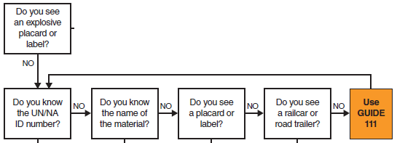
Little/No Information or Danger Placard
?
If you have no information on the material involved, use Guide 111 UNTIL additional information is obtained
Overview
Usage
Other info
CANUTEC

Slide 70
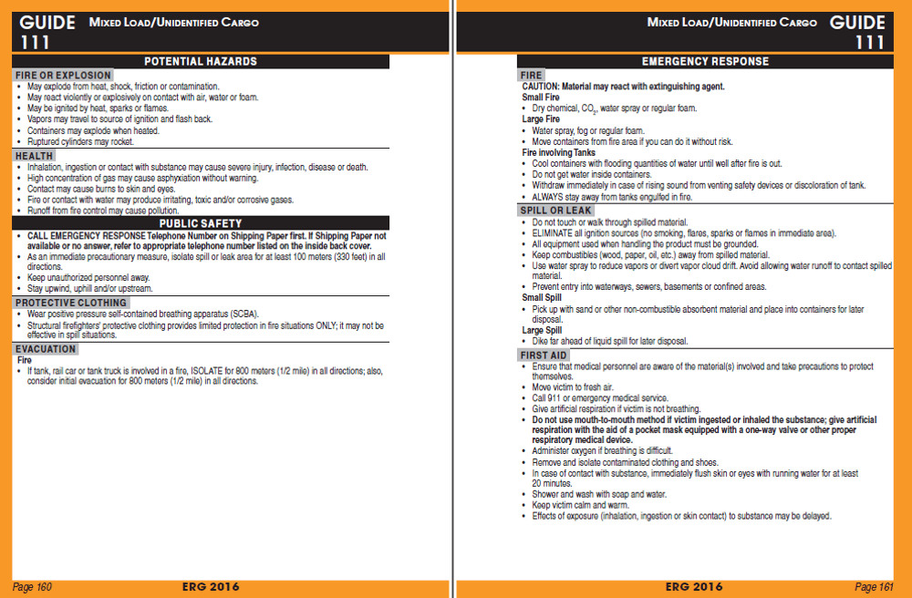

Slide 71
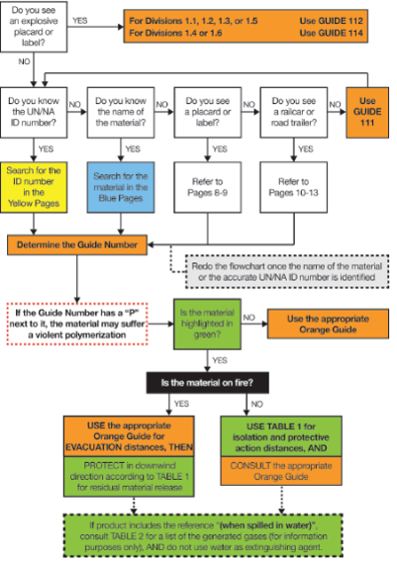
Remember to redo the flowchart!
Whenever new information on the product become available, redo the flowchart.
You want to use the most accurate information when choosing the Guide Number.

Slide 72
How to use the ERG2016
I have found the Guide Number.
What else do I do?
Overview
Usage
Other info
CANUTEC

Slide 73
How to use the ERG2016
Once you have figured out the Guide Number to use, keep following the flowchart.
You will see two special cases:
Letter “P”; and
Substances highlighted in GREEN

Slide 74
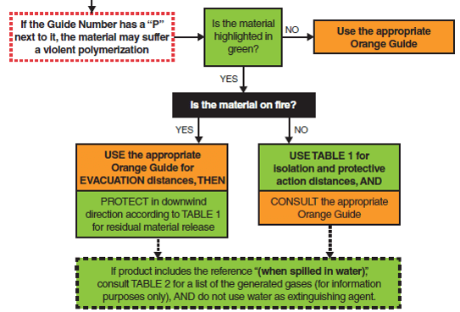
Letter “P”
Found a Guide Number with “P”?
Overview
Usage
Other info
CANUTEC

Slide 75
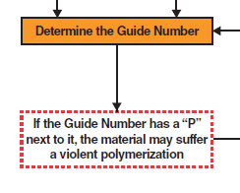
Letter “P”
In the YELLOW and BLUE Sections:
If the 3-digit Guide Number is followed by
the letter “P” (e.g., 116P), the material may undergo violent polymerization if subjected
to heat or contamination.
This polymerization will produce heat and may lead to pressure build-up in containers. This can cause containers to explode or rupture.
i.e. Ethylene
Overview
Usage
Other info
CANUTEC

Slide 76
GREEN Highlighted Substances
Found a substance highlighted in GREEN?
Overview
Usage
Other info
CANUTEC

Slide 77
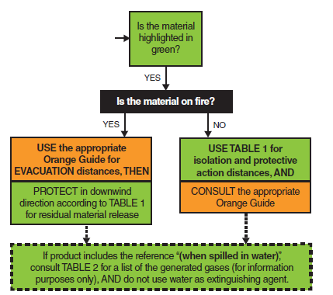
GREEN Highlighted Substances
Info found in GREEN Section of the book
If the material is highlighted in GREEN in the YELLOW and BLUE Sections, it is considered a TIH/ water reactive/ chemical warfare agent.
Overview
Usage
Other info
CANUTEC

Slide 78
GREEN Highlighted – NO fire
In the YELLOW and BLUE Sections, if the substance is highlighted in GREEN:
IF THERE IS NO FIRE:
Go directly to Table 1 (GREEN-bordered pages);
Look up the ID (UN) number and name of material;
Identify initial isolation and protective action distances;
Also consult the appropriate ORANGE Guide.
Overview
Usage
Other info
CANUTEC

Slide 79
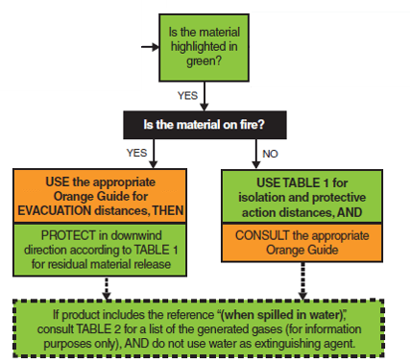
GREEN Highlighted – Fire
In the YELLOW and BLUE Sections, if the substance is highlighted in GREEN:
IF A FIRE IS INVOLVED:
Consult the assigned ORANGE Guide;
If applicable, apply the Evacuation distances shown under Public Safety;
The distance provided in Public Safety section may be greater than the distance in the GREEN tables.
Overview
Usage
Other info
CANUTEC

Slide 80
Summary: What is needed?
Presence of an explosives placard;
An ID (UN/NA) number;
Name of the material;
The placard of the product;
The railcar type;
The road trailer type;
Or: Use Guide 111;
Until further information is available
Redo the flowchart, if required.
Overview
Usage
Other info
CANUTEC

Slide 81
How to use ERG2016 – Question 1
What is the implication when there is a “P” next to the Guide Number in the YELLOW and BLUE Sections?
Overview
Usage
Other info
CANUTEC

Slide 82
How to use ERG2016 – Q1 Answer
“P” is for polymerization. This polymerization will produce heat and may lead to pressure build-up in containers. This can cause containers to explode or rupture.
Reference: ERG2016 Page 383
Overview
Usage
Other info
CANUTEC

Slide 83
How to use ERG2016 – Question 2
You see a tanker truck on its side with the following information on the truck. What is the Emergency Response Guide Number and is there anything special about this product?
1050

Slide 84
How to use ERG2016 – Q2 Answer
With the ID (UN) number, you can identify the Guide number in the YELLOW Section (page 28). The product is Hydrogen chloride, anhydrous.
Refer to Guide 125;
No “P” after the Guide number;
Highlighted in GREEN; may need to refer to GREEN Section.
Overview
Usage
Other info
CANUTEC

Slide 85
How to use ERG2016 – Question 3
You see a tanker truck on its side with the following information on the shipping document but the ID (UN) number is illegible. What is the Emergency Response Guide Number and is there anything special about this product?
ISOBUTYLAMINE, Class 3(8), Packing Group II
Overview
Usage
Other info
CANUTEC

Slide 86
How to use ERG2016 – Q3 Answer
With the chemical name, you can find the Guide Number from the BLUE Section (page 124). The product ID is UN1214.
Refer to Guide 132;
No “P” after the Guide Number;
Product is NOT highlighted in GREEN; therefore, no need to consult the GREEN Section.
Overview
Usage
Other info
CANUTEC

Slide 87
How to use ERG2016 – Question 4
You see a tanker truck on its side with the following information on the truck. What is the Emergency Response Guide Number and is there anything special about this product?

Slide 88
How to use ERG2016 – Q4 Answer
Only the placard is available, thus pages 8-9 should be consulted.
This placard refers to Guide 122;
You will need to redo the flowchart when more information is available.
Overview
Usage
Other info
CANUTEC

Slide 89
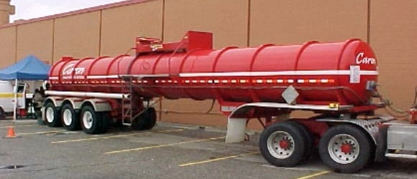
How to use ERG2016 – Question 5
You see a tanker truck on its side with the following information on the truck. What is the Emergency Response Guide Number and is there anything special about this product?
Alberta Transportation

Slide 90
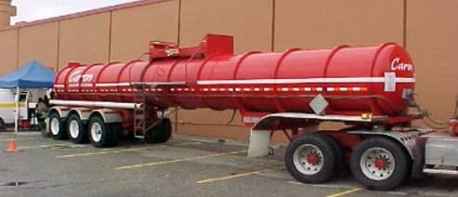
How to use ERG2016 – Q5 Answer
On page 13 of the ERG2016, this type of silhouette refers to Guide 137, which indicates that the distances for this substance may be in Table 1. More information is required to know if this product is a TIH.

Slide 91
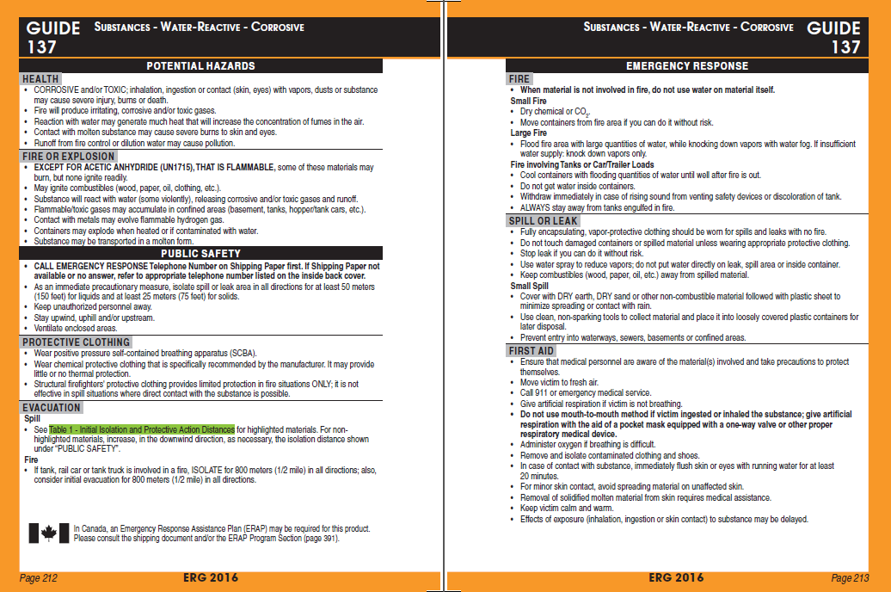
Guide 137 refers to Table 1. More information is required to know if the product is highlighted in GREEN in the YELLOW or BLUE Sections.
YELLOW

Slide 92
How to use ERG2016 – Question 6
You see a tanker truck on its side with the following information on the truck. What is the Emergency Response Guide Number and is there anything special about this product?

Slide 93
How to use ERG2016 – Q6 Answer
You can see the DANGER placard, but there is not much information on the identity of the substances involved. Use Guide 111 until more information is found.
Try to find more information to know the exact identity of the products involved and then redo the flowchart.
Overview
Usage
Other info
CANUTEC

Slide 94
ERG2016 – Other Information
Overview
Usage
Other info
CANUTEC

Slide 95
Other information in the ERG2016
BLEVE Table – including cooling water flow rates (pages 368-369);
Indicators of Possible Chemical/ Biological/ Radiological Incidents (page 370-373);
Improvised Explosive Device (IED) Stand-off Distances (pages 374-375);
Emergency Contact Information (page 390-392).
Emergency Response Assistance Plans (ERAP) (page 391)
Overview
Other info
Usage
CANUTEC

Slide 96
BLEVE
Definition : Boiling Liquid Expanding Vapour Explosion
A BLEVE happens if a container holding a pressurized liquefied gas fails catastrophically. Catastrophic failure of the vessel is followed by the explosive release of boiling liquid and expanding vapour.
NOTE: A BLEVE can occur even if the material is non-flammable.
Overview
Other info
Usage
CANUTEC

Slide 97
BLEVE
When confronted with a possible BLEVE involving Liquefied Petroleum Gases (LPG), important safety-related information can be found on page 368 of the ERG2016:
LPGs (UN1075) include the following flammable gases:
The main hazards from an LPG BLEVE are:
Fire;
Thermal radiation from the fire;
Blast; and
Projectiles.
Butane, UN1011 | Propylene, UN1077
Butylene, UN1012 | Isobutane, UN1969
Isobutylene, UN1055 | Propane, UN1978
Overview
Other info
Usage
CANUTEC

Slide 98
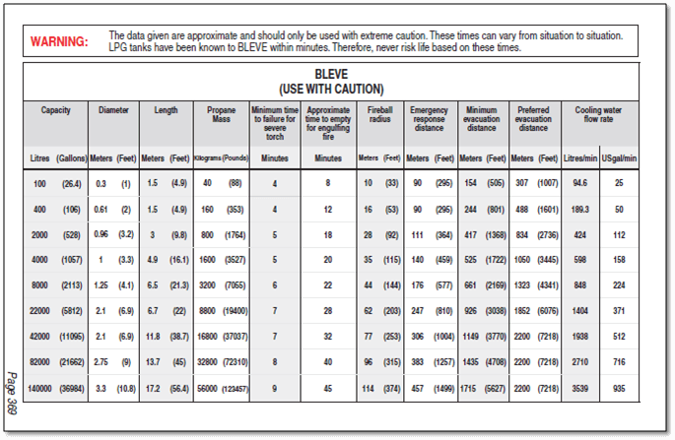
BLEVE
The following table gives a summary of tank properties, critical times, critical distances and cooling water flow rates for various tank sizes that may be involved in a BLEVE.

Slide 99
Indicators of CBRN
The indicators for the presence of Chemical / Biological / Radiological / Nuclear (CBRN) agents can be found on pages 370-372.
Below are just a few examples of indicators but many more are found in the ERG2016:
Chemical Incident – Low-lying clouds;
Biological Incident – Unusual number of sick or dying people or animals;
Radiological Incident – Heat emitting material.
Overview
Other info
Usage
CANUTEC

Slide 100
Improvised Explosive Device (IED)
An Improvised Explosive Device is a bomb that is manufactured from commercial, military or homemade explosives.
A Safe Stand-off Distance Chart for various threats when Improvised Explosive Devices are involved is found on pages 374-375 of the ERG2016.
Overview
Other info
Usage
CANUTEC

Slide 101
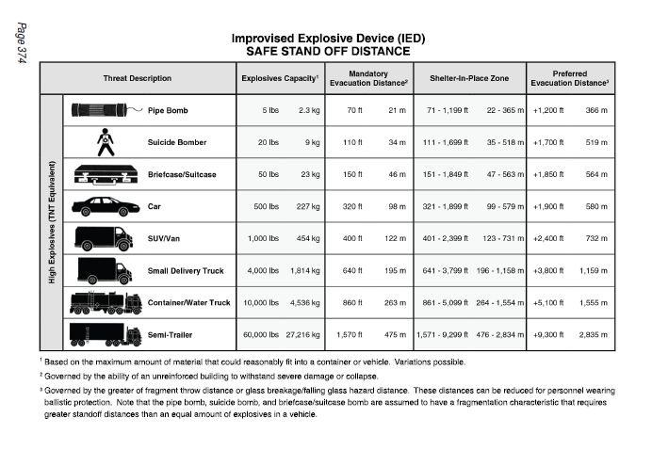

Slide 102
Emergency Contact
To obtain more detailed information on the substance involved, the safety precautions and risk mitigation procedures:
Dial the emergency telephone number listed on the shipping document*;
OR
Contact the appropriate emergency response agency as soon as possible (numbers are listed on the inside back cover of the ERG2016)
* In Canada, this number could be CANUTEC’s telephone number
1-888-CANUTEC (1-888-226-8832), 613-996-6666, or *666
Overview
Other info
Usage
CANUTEC

Slide 103
Emergency Contact
Page 390 of the ERG2016 provides the telephone numbers of the provincial agencies that must¹ be contacted for any incident involving dangerous goods.
Additionally, CANUTEC may² be contacted in order to get more detailed technical information on the dangerous goods involved.
¹ Canadian Federal and Provincial Regulations Requirements
² Even if CANUTEC’s telephone number is not shown on the shipping document
Overview
Other info
Usage
CANUTEC

Slide 104
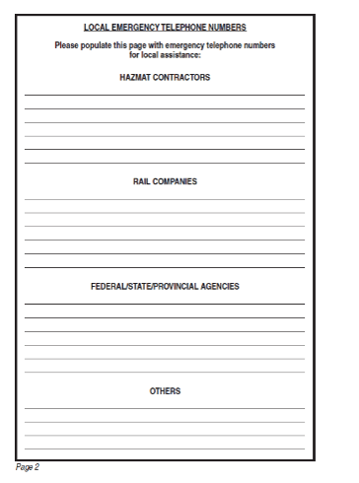
Emergency Contact
Page 2 of the ERG2016 contains a page to be filled by the user that contains local numbers to reach dangerous goods contractors, rail companies, government agencies.
Overview
Other info
Usage
CANUTEC

Slide 105
Knowledge – Question 1
Read page 370-372, and list three indicators of a Chemical, Biological and Radiological Incidents.
Overview
Other info
Usage
CANUTEC

Slide 106
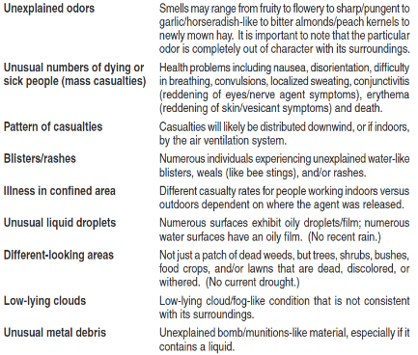
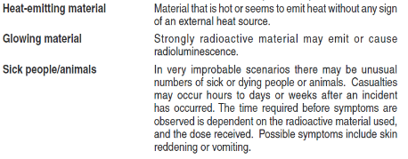
Knowledge – Question 1 (Answer)
Overview
Other info
Usage
CANUTEC

Slide 107
Knowledge – Question 2
Name the four main hazards of an LPG BLEVE.
Overview
Other info
Usage
CANUTEC

Slide 108
Knowledge – Question 2 (Answer)
The four main hazards of an LPG BLEVE are :
Fire;
Thermal radiation from the fire;
Blast; and
Projectiles.
Overview
Other info
Usage
CANUTEC

Slide 109
CANUTEC
Overview
Usage
Other info
CANUTEC

Slide 110
CANUTEC
CANUTEC is the Canadian Transport Emergency Centre and is operated by the Transportation of Dangerous Goods Directorate at Transport Canada.
CANUTEC provides a national bilingual advisory service. It is staffed by professional scientists experienced and trained to provide technical information and emergency response advice.
Overview
CANUTEC
Usage
Other info

Slide 111
CANUTEC
In case of an emergency, dial, 24 hours a day, 7 days a week:
1-888-CAN-UTEC (1-800-226-8832), or
(613) 996-6666, or
*666 on a cellular phone (Canada only).
In a non-emergency situation, please call the information line available 24 hours a day, 7 days a week at (613) 992-4624,
By email: CANUTEC@tc.gc.ca
Overview
CANUTEC
Usage
Other info

Slide 112
ERG2016
This presentation was produced by CANUTEC personnel and is made available to any user / trainer of the Emergency Response Guidebook.
Permission is given to use and modify this presentation if needed. But all mentions of Transport Canada / Transportation of Dangerous Goods Directorate must be removed (except for slide 112 - CANUTEC).
Any comments should be directed to CANUTEC through the information line (613-992-4624) or by email at CANUTEC@tc.gc.ca

Slide 113
Questions?

